Slide 1



Laser Security Alarm System
KAMALESH BADOLA 1NH20EE048
KUSHAL NAIK K 1NH20EE056
LAVA KUMAR M N 1NH20EE057
MOHAMMED AMAN 1NH21EE407
MINI PROJECT 20EEL68
Date of Presentation: 15.06.2023
Guided By
Dr. Vinoth Kumar K
Associate Professor
Department of Electrical & Electronics Engineering
Bengaluru 560103, Karnataka, India

Slide 2
INTRODUCTION
Advanced Security Solution: The Laser-Based Security Alarm System is a cutting-edge security solution that utilizes laser technology and intelligent detection algorithms to provide enhanced protection against intruders and unauthorized access.
Laser Beam Barrier: The system employs strategically placed laser beams to create an invisible barrier or perimeter. When the laser path is disrupted, such as by an intruder crossing the beam, the alarm system is triggered.
Accurate Detection and Minimized False Alarms: By leveraging laser technology, the system offers precise and reliable detection, minimizing false alarms caused by environmental factors like dust or small animals. Intelligent algorithms help distinguish genuine threats from false triggers.
Discreet and Effective: The invisible nature of laser beams makes the system discreet, preventing potential intruders from easily identifying the security measures in place. It offers a robust and effective means of securing entry points and valuable areas.
Future Potential and Scalability: The project aims to explore improvements and potential applications of laser-based security systems. Through research and experimentation, it seeks to contribute to the advancement of security technologies and inspire further innovation in the field.

Slide 3
Objective
Develop a laser-based security alarm system that utilizes laser technology, intelligent detection algorithms, and precise beam placement to accurately detect intruders, minimize false alarms ,to capture the intruder and enhance overall security measures.
2

Slide 4
PROBLEM STATEMENT
The existing security systems lack accurate detection and suffer from false alarms, necessitating the development of a laser-based security alarm system that provides precise intruder detection and minimizes false triggers, ensuring enhanced security measures.

Slide 5
LITERATURE SURVEY
Title of the paper | Author | Source & Year of Publication | Outcome of the paper
"Design and Development of a Laser Security System" Low Cost Laser Light Security System in Smart Home Design and Implementation of Laser-Based Security System" | S. Anbazhagan and R. Sudhakaran Ashis Rai, Manjil Rai, Nisha Jogi A. Srinivasan, K. Ganeshkumar, and G. Gokul. | International Journal of Computer Applications, January 2014. 2017 Second International Conference on Electrical, Computer and Communication Technologies (ICECCT) , IEEE International Journal of Engineering Research & Technology, Volume 2, Issue 6, June 2013 | The system detects intrusions using a laser module and triggers an alarm. When the laser beam is interrupted, an alarm is triggered to alert the user of a potential security breach. The design and implementation of a laser-based security system using a laser transmitter and a receiver

Slide 6

BLOCK DIAGRAM
Laser Module KY-008
LM393 LDR Module
ESP-32 CAM
UART TTL
Blynk Server
Blynk App

Slide 7
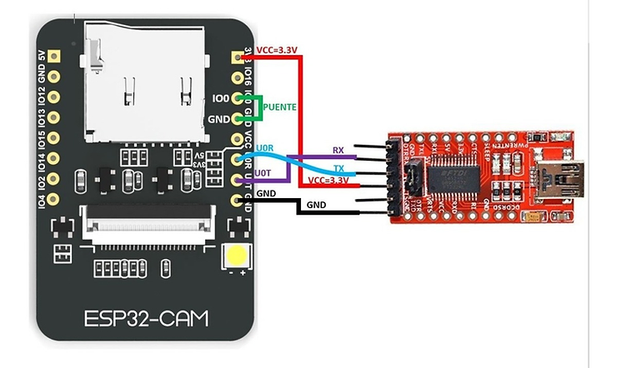
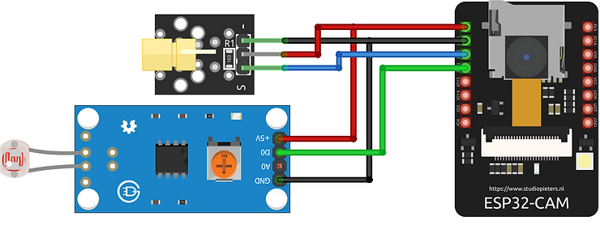
CIRCUIT DIAGRAM

Slide 8
COMPONENTS REQUIRED
LASER Diode Module KY-008
LDR Module
Connecting Wires
ESP32cam
UART TTL
Bread Board
Blynk App

Slide 9
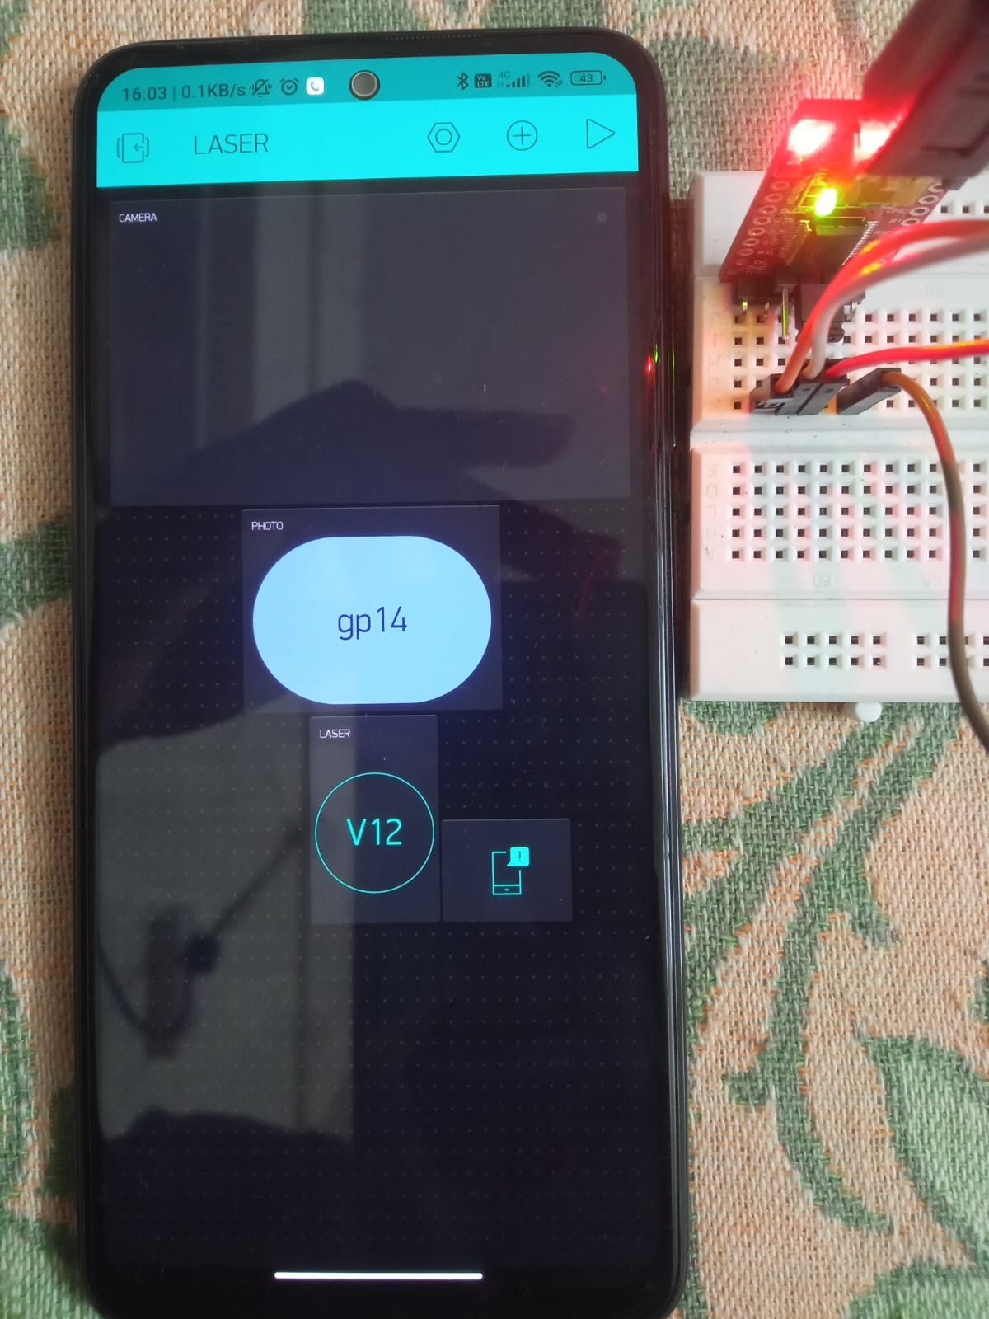
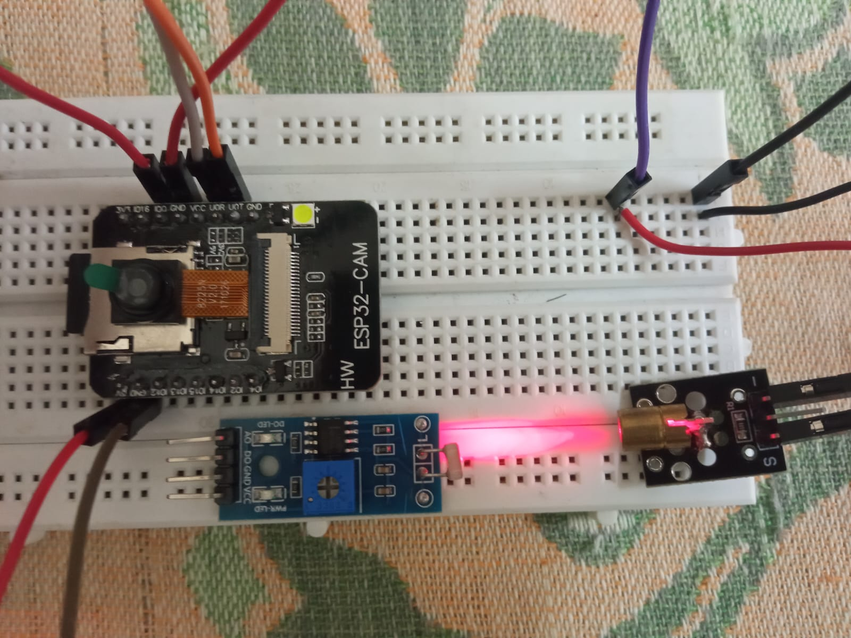
HARDWARE PICTURE

Slide 10
ADVANTAGES
Invisible Barrier: Unlike traditional security systems that rely on visible physical barriers, the Laser Security Alarm System uses an invisible laser beam as its primary line of defense.
Real-Time Image Capture: The integration of the camera module in the Laser Security Alarm System enables real-time image capture upon detecting an intrusion. This creative advantage provides visual evidence of the security event, which can be crucial for identification, evidence gathering, and subsequent actions.
Mobile Connectivity: The integration of the Blynk IoT app allows users to receive real-time notifications and remotely monitor the security system on their mobile devices. This creative advantage offers convenience and flexibility, enabling users to stay connected and informed about security events from anywhere.
Customization and Expandability: The Laser Security Alarm System offers a high level of customization and expandability. Users can tailor the system to their specific security needs by adjusting parameters such as the sensitivity of the LDR module or integrating additional components for enhanced functionality

Slide 11
DISADVANTAGES
Limited Coverage Area: The laser-based security alarm system's coverage area is limited by the placement and range of laser diode modules. Multiple modules may be required to cover larger areas effectively, leading to increased implementation complexity and cost.
Susceptible to Environmental Interference: External factors such as heavy fog, rain, or extreme dust can interfere with the laser beams, potentially causing false alarms or reducing the system's effectiveness. Additional precautions or environmental adjustments may be necessary in such situations.
Power Dependency: The laser-based security alarm system requires a continuous power supply to function properly. Any disruption or power outage can render the system inactive, leaving the protected area temporarily vulnerable.
Limited Detection Modes: The system's current configuration primarily focuses on intrusion detection through laser interruption. It may lack advanced features such as motion sensing or facial recognition, which could limit its capabilities compared to more sophisticated security systems.
Technical Expertise Required: While the laser-based security alarm system is designed for relatively easy installation, users may still need a basic understanding of electronics and programming to set up and troubleshoot the system effectively. This could be a challenge for individuals without technical expertise.

Slide 12
FUTURE SCOPE
Integration of AI and Machine Learning: Enhancing the laser-based security alarm system with AI and machine learning algorithms for improved adaptability and accuracy.
Smart Home Integration and Advanced Surveillance: Integrating the system with smart home technologies and surveillance systems to enable remote monitoring and advanced identification capabilities.

Slide 13
CONCLUSION
The Laser Security Alarm System offers an innovative and efficient solution for enhancing security measures. By utilizing an invisible laser beam, real-time image capture, mobile connectivity, customization options, and integration capabilities, it provides a unique approach to security. Overall, the Laser Security Alarm System presents a creative solution that combines advanced technology with personalized customization for improved security outcomes.

Slide 14
REFERENCES
"Design and Development of a Laser Security System" by S. Anbazhagan and R. Sudhakaran. International Journal of Computer Applications, Volume 85, Issue 14, January 2014.
"Laser Security System for Home Security" by A. T. Jeyaraj, R. Balasubramanian, and V. Arumugam. International Journal of Advanced Research in Computer Engineering & Technology, Volume 2, Issue 4, April 2013.
"Design and Implementation of Laser-Based Security System" by A. Srinivasan, K. Ganeshkumar, and G. Gokul. International Journal of Engineering Research & Technology, Volume 2, Issue 6, June 2013.
"Laser Security System" by P. Mahalingam, S. M. Surya, and V. Arun. International Journal of Engineering Science and Computing, Volume 6, Issue 4, April 2016.
"Laser Security System Using Arduino and GSM Module" by M. D. Nasiruddin, S. Ferdoush, and M. R. A. D. Chowdhury. International Journal of Scientific & Engineering Research, Volume 9, Issue 7, July 2018.

Slide 15


